Slide 1
Node.js chat app
I Gusti Agung Agastya T.

Slide 2
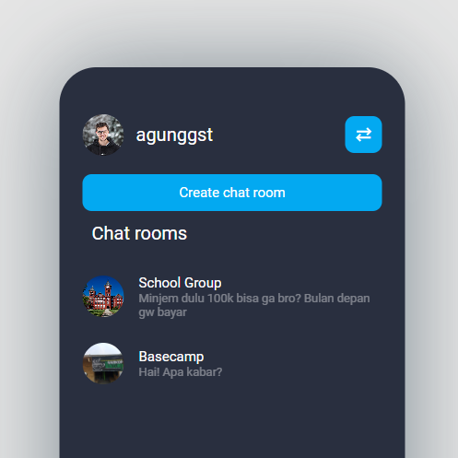
Pendahuluan
Pada project ini saya membuat aplikasi chat menggunakan Node.js + Express, Sequelize sebagai orm-nya, PostgreSQL, dan EJS sebagai library untuk tampilannya. Project ini bertujuan untuk mendalami lebih lanjut mengenai relasi database many-to-many pada PostgreSQL dan Sequelize

Slide 3
Timeline Pengerjaan
Day 1
Untuk memulai project ini, pada hari pertama saya membuat product requirement document (PRD), sketsa desain, dan relational diagram
Day 2
Pada hari kedua, mulai mengeksekusi hasil dari rancangan yang sudah dibuat padah hari pertama. Inisiasi db, inisiasi project dll.
Day 3
Melanjutkan pembuatan Back-end, serta memulai membuat halaman utama.
Day 4
Finishing applikasi serta melakukan test untuk mengecek apakah masih ada error.
Day 5
Pembuatan dokumentasi dan power point.

Slide 4
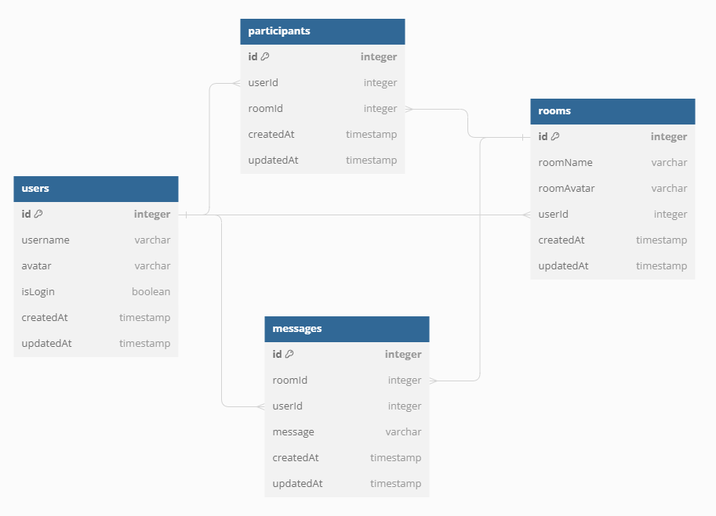
Entity Relationship Diagram (ERD)

Slide 5
Technology Stack
Node.js
Express.js
Sequelize + PosgreSQL
EJS

Slide 6
Documentation
https://github.com/agunggst/Node-js-chat-app

Slide 7
Demo applikasi

Slide 8




Thank you

Slide 9
Chart

Slide 10
Table
 | Category 1 | Category 2 | Category 3 | Category 4
Item 1 | 4.5 | 2.3 | 1.7 | 5
Item 2 | 3.2 | 5.1 | 4.4 | 3
Item 3 | 2.1 | 1.7 | 2.5 | 2.8
Item 4 | 4.5 | 2.2 | 1.7 | 7

Slide 11
Title 2 column
Subtitle
Subtitle
Add text, images, art, and videos.
Add transitions, animations, and motion.
Save to OneDrive to get to your presentations from your computer, tablet, or phone.
Open the Design Ideas pane for instant slide makeovers.
When we have design ideas, we’ll show them to you right there.

Slide 12
Title 3 column
Subtitle
Subtitle
Subtitle
Add text, images, art, and videos.
Add transitions, animations, and motion.
Save to OneDrive to get to your presentations from your computer, tablet, or phone.
Open the Design Ideas pane for instant slide makeovers.
When we have design ideas, we’ll show them to you right there.
This PowerPoint theme uses its own unique set of colors, fonts, and effects to create the overall look and feel of these slides.
PowerPoint has tons of themes to give your presentation just the right personality.

Slide 13



Summary
With PowerPoint, you can create presentations and share your work with others, wherever they are. Type the text you want here to get started. You can also add images, art, and videos on this template. Save to OneDrive and access your presentations from your computer, tablet, or phone.

Slide 14

Agenda
Topic one
Topic two
Topic three
Topic four

